Slide 1
Practical Malware Analysis
Chapter 16: Anti-Debugging
Chapter 17: Anti-Virtual Machine Techniques
2026.02.13
Seyoung Jin

Slide 2
Anti-Debugging
Chapter 16: Anti-Debugging
Its primary goal is to delay analysis and increase the analyst’s workload, making debugging difficult
Anti-debugging is a technique used by malware to detect whether it is being analyzed under a debugger or to disrupt the debugger’s normal operation
No
Execute a malicious payload
If a debugger is detected?
Change the execution flow
Terminate itself
Yes
Main mechanisms
Windows Debugger Detection
Identifying Debugger Behavior
Interfering with Debugger Functionality
Debugger Vulnerabilities

Slide 3
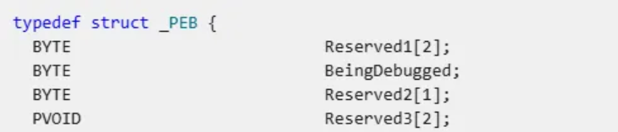
Using the Windows API
Chapter 16: Anti-Debugging - ① Windows Debugger Detection
Process Environment Block (PEB) structure
0 = No debugger
1 = Debugger attached
Leverage the official API to check if a process is being debugged
IsDebuggerPresent() | A function to check if the current process is being debugged Check the BeingDebugged flag in the Process Environment Block (PEB)
CheckRemoteDebuggerPresent() | Checks if a debugger is attached to a specific process on the local machine
NtQueryInformationProcess() | Retrieves the ProcessDebugPort information of a specified process Returns the debug port number if debugged attached; otherwise, it returns 0
OutputDebugString() | Sends string to debugger Error code differs depending on the presence of the debugger
Analyst's Bypass Strategy
Modify the malware during execution to prevent calls to the anti-debugging API
Adjust the return value or flags after the API call to ensure the desired execution path

Slide 4
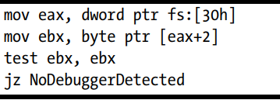
Manually Checking Structures
Chapter 16: Anti-Debugging - ① Windows Debugger Detection
Process Environment Block (PEB) structure
0 = No debugger
1 = Debugger attached
Because APIs can be hooked and manipulated to return incorrect results, malware often manually checks PEB fields used in anti-debugging
PEB Fields | Offset
BeingDebugged | +0x02 | Indicates whether a debugger is attached (0 = No, 1 = Debugger)
ProcessHeap (pointer) | +0x18 | Heap contains Flags and ForceFlags fields, which have non-zero values ​​if the heap was created by a debugger
NTGlobalFlag | +0x68 | Contains information about how the system creates the heap structure Set to a specific value (0x70) when debugged
// PEB start address
Analyst's Bypass Strategy
Modify the Zero Flag (ZF) before the conditional jump
Manually change the BeingDebugged flag to 0
//BeingDebugged
// ebx=0 (Zero flag = 1)

Slide 5
Checking for System Residue
Chapter 16: Anti-Debugging - ① Windows Debugger Detection
Malware detects traces that debugging tools leave on the system
Registry keys check
- This registry key specifies the debugger activated when an application error occurs
- Check whether the default debugger (e.g., Dr. Watson) has been changed to OllyDbg
File & Directory Scanning
- Search for the debugger executable name or debugger-related files/directory
Memory & Process Inspection
- Scans running processes for debugger names → FindWindow("OLLYDBG")

Slide 6
INT Scanning
Chapter 16: Anti-Debugging - ② Identifying Debugger Behavior
When the debugger sets a breakpoint, the original instruction in the malware is replaced with an INT 3 instruction (opcode: 0xCC) → Software breakpoints
Malware
Scans for 0xCC (INT Scanning)
Performs CRC/MD5 checksums to identify code modifications
Analyst's Bypass Strategy
Use hardware breakpoints to trigger interrupts using CPU-debug registers without modifying the original code
OllyDbg (1.x/2.x): Right-click the target address → Breakpoint → Hardware breakpoint

Slide 7
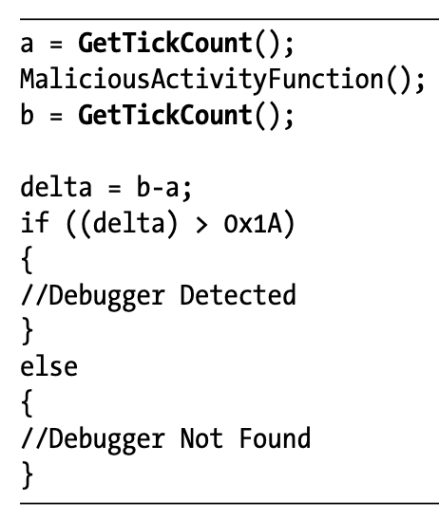
Timing Checks
Chapter 16: Anti-Debugging - ② Identifying Debugger Behavior
A technique for detecting execution delays caused by single-step execution of a debugger
Malware
Measure the time required to handle exceptions or execute tasks
Use timing-related functions: rdtsc, QueryPerformanceCounter, GetTickCount
Analyst's Bypass Strategy
Identify patterns where timing-related functions are called consecutively and compared
Run the code at full speed during the timing check, then resume single-stepping afterward

Slide 8
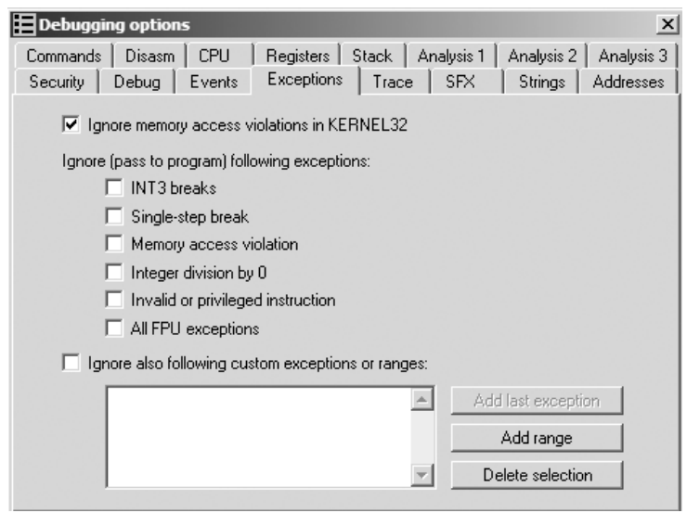
Using Exceptions
Chapter 16: Anti-Debugging – ③ Interfering with Debugger Functionality
Most debuggers intercept exceptions by default and do not pass them to the program until the analyst responds
Options ▶ Debugging Options ▶ Exceptions
To detect debuggers, a malware can intentionally raise an exception and verify that its own exception handler executes properly
Analyst's Bypass Strategy
Use debugging options to allow all exceptions to pass to the program (check the box)

Slide 9
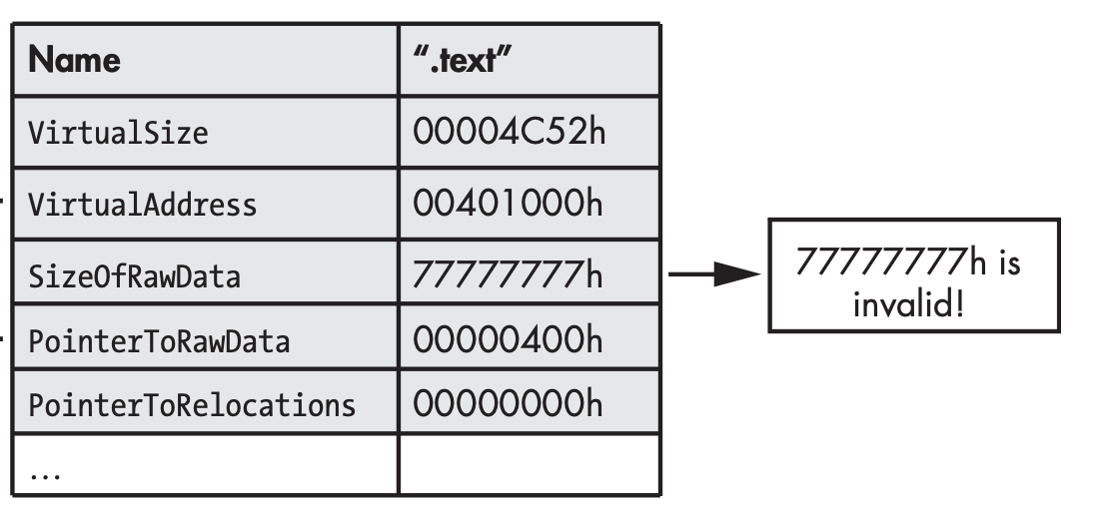
Debugger Vulnerabilities
Chapter 16: Anti-Debugging - ④ Debugger Vulnerabilities
Intentionally setting the SizeOfRawData field to an excessively large value (e.g., 0x77777777)
Malformed arguments (e.g. OutputDebugString("%s%s")) can crash OllyDbg 1.1.

Slide 10
Anti-Virtual Machine Techniques
Chapter 17: Anti-Virtual Machine Techniques
Objective
Detect whether malware is running inside a Virtual Machine (VM)
Honeypots typically run on virtual machines, but regular user environments do not
If a VM is detected, terminate execution or alter behavior
Trend
Commonly found in widespread malware (e.g., bots, scareware, spyware)
Recently declining due to widespread virtualization use by administrators and regular users (e.g., snapshots for system recovery)

Slide 11
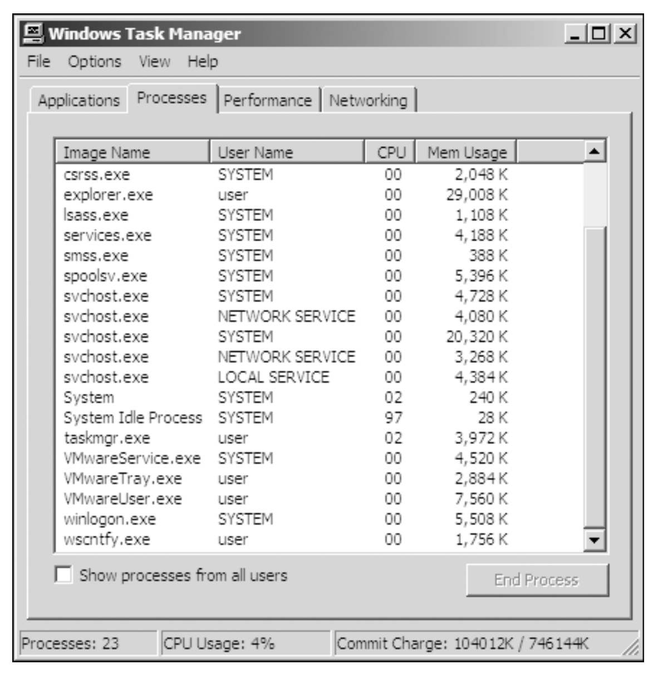
VMware Artifact-based detection
Chapter 17: Anti-Virtual Machine Techniques
① Processes/System service
VMware leaves its own unique footprint on the system, especially if VMware Tools is installed
Check for the string "VMware" in the list of running processes/system services
C:\> net start | findstr VMware
VMware Physical Disk Helper Service
VMware Tools Service

Slide 12
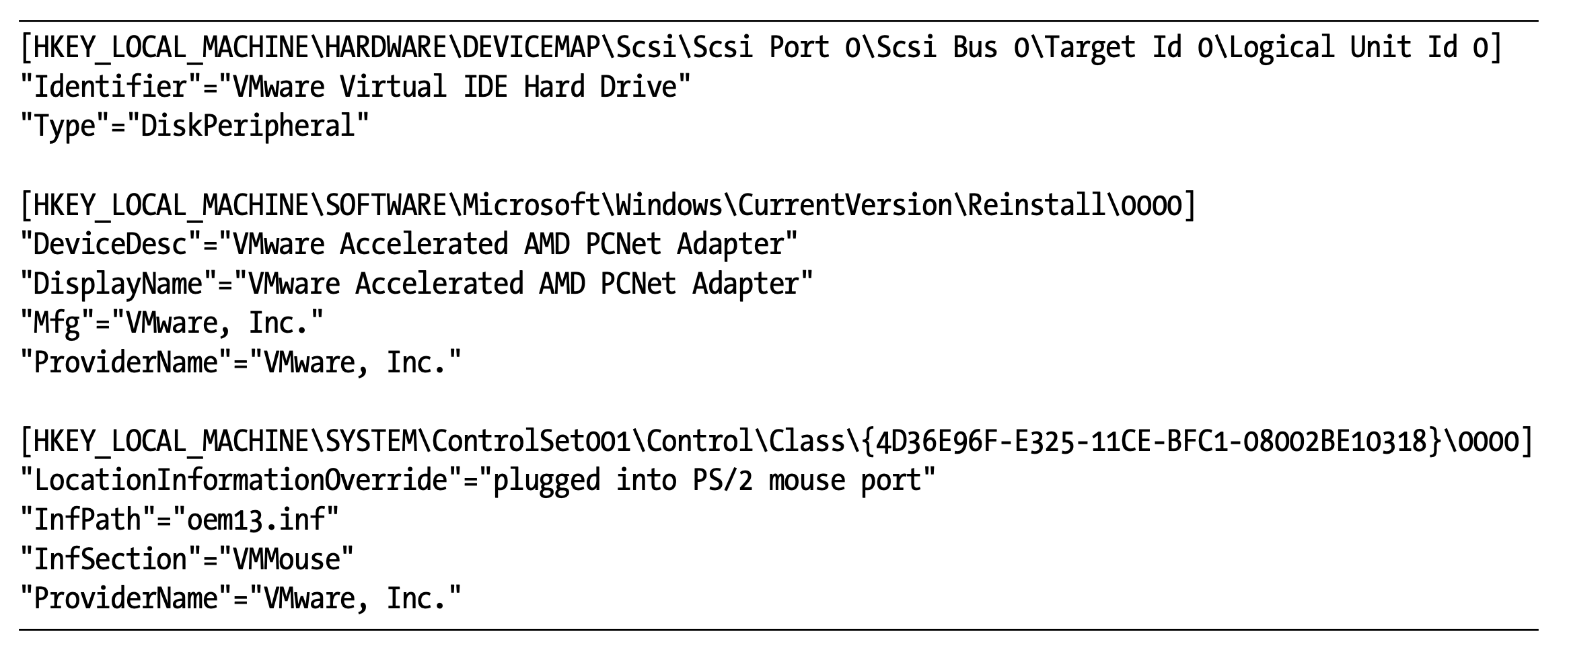
VMware Artifact-based Detection
Chapter 17: Anti-Virtual Machine Techniques
② Registry/Hardware information
Filesystem
VMware installation directory (e.g., C:\Program Files\VMware\VMware Tools)
MAC Address
VMware virtual NIC MAC addresses typically begin with 00:0C:29
Registry
VMware-related registry key entries (e.g., Hard Drive, adapter, mouse)
Analyst's Bypass Strategy
Remove VMware Tools or stop related services (e.g., net stop "VMware Tools Service")
Modify specific strings to make string comparison checks fail (e.g., "VMwareTray.exe" → "XXXareTray.exe" )

Slide 13
Vulnerable Instructions-based Detection
Chapter 17: Anti-Virtual Machine Techniques
A detection technique that exploits the fact that certain user-mode instructions return different values in a VMware (guest OS) compared to a physical machine (host OS)
Vulnerable instructions: sidt, sgdt, sldt, smsw, str, in, cupid
Red Pill anti-VM technique
Use the sidt instruction to read the IDTR (Interrupt Descriptor Table Register)
Check its fifth byte; if it is 0xFF, VMware is assumed
CPU
IDT
(Interrupt Descriptor Table)
Host IDT : 0x8043F4001111
Guest IDT : 0xFF1230001111
VMware's signature
IDTR (6byte)
Analyst's Bypass Strategy
Automatically identify anti-VM instructions (e.g., sidt) and bypass it by inserting NOP instructions or modifying conditional jumps

Slide 14
Lab
Chapter 16: Anti-Debugging (Lab 16-1)
Analyze the malware found in Lab16-01.exe using a debugger.
Q1. Which anti-debugging techniques does this malware employ?
Q2. What happens when each anti-debugging technique succeeds?
Q3. How can you get around these anti-debugging techniques?
Q4. How do you manually change the structures checked during runtime?
Q5. Which OllyDbg plug-in will protect you from the anti-debugging techniques used by this malware?

Slide 15


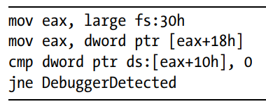

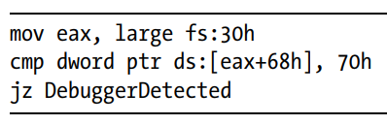
Q1. Which anti-debugging techniques does this malware employ?
Chapter 16: Anti-Debugging (Lab 16-1)
Windows debugger detection techniques
The malware checks the status of the BeingDebugged, ProcessHeap, and NTGlobalFlag flags
BeingDebugged
ProcessHeap
NTGlobalFlag

Slide 16
Q2. What happens when each anti-debugging technique succeeds?
Chapter 16: Anti-Debugging (Lab 16-1)
If any of the malware’s anti-debugging techniques succeed, it will terminate.

Slide 17
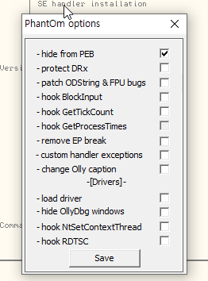
Q3. How can you get around these anti-debugging techniques?
Chapter 16: Anti-Debugging (Lab 16-1)
Using plugins like OllyDbg, you can quickly and easily modify the BeingDebugged, ProcessHeap, and NTGlobalFlag flags that malware checks in memory
PhantOm
If we select the first option, Hide from PEB, the BeingDebugged flag will be set to 0 the next time OllyDbg loads the malware.
PhantOm, https://github.com/JackAston/OllyDbg1plugins/tree/master

Slide 18
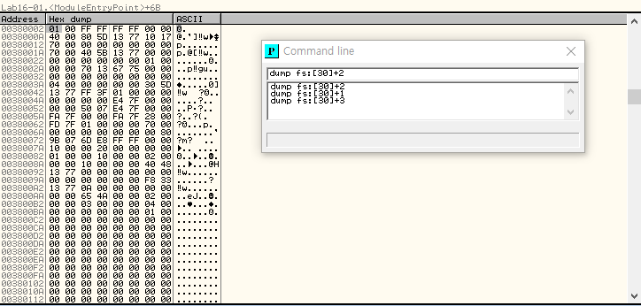
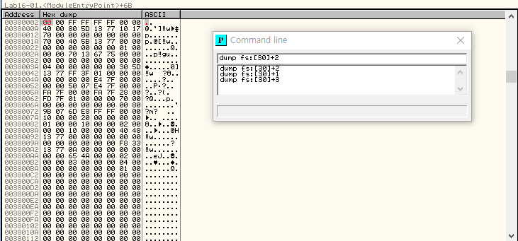
Q4. How do you manually change the structures checked during runtime?
Chapter 16: Anti-Debugging (Lab 16-1)
We can just dump the PEB contents in OllyDbg and then fill those addresses with 0 (0x00)
Select Plugins ▶Command Line
Right-click the flag value and select Binary ▶ Fill With 00’s
BeingDebugged

Slide 19

Q5. Which OllyDbg plug-in will protect you from the anti-debugging techniques used by this malware?
Chapter 16: Anti-Debugging (Lab 16-1)
PhantOm

Slide 20
Thank you.

